Slide 1
4. Acid and base reactions
GE002

Slide 2
You need to be able to….
Write the word equation and identify reactants and products in balanced chemical equations for reactions, including;
Acid and base (metal oxides or hydroxides)
Acid and metal
Acid and carbonate

Slide 3
You need to be able to….
Predict the products from observations from reactions, including;
Acid and base (metal oxides or hydroxides)
Acid and metal

Slide 4

Neutralisation
Acid + Base
Salt + Water
METAL from the BASE and
Chloride, sulphate or nitrate from the ACID
e.g. Sodium chloride from hydrochloric acid and sodium hydroxide
HCl + NaOH >>>> NaCl + H₂O

Slide 5
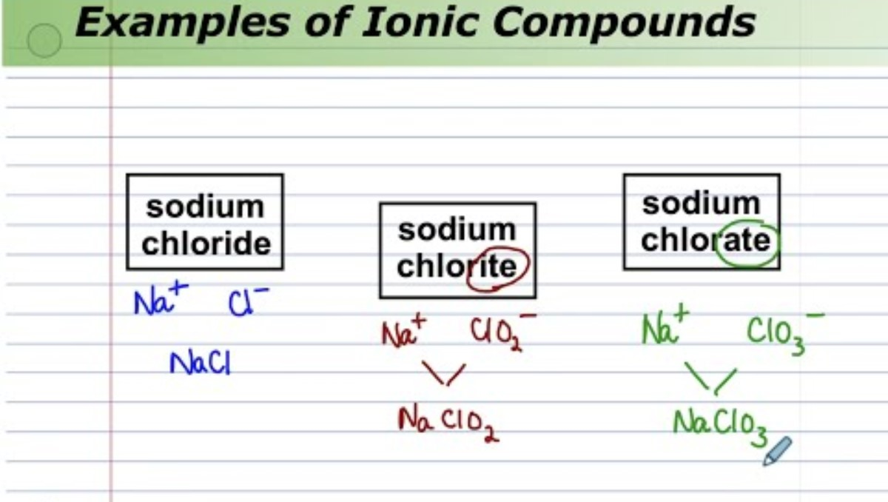

Slide 6
Chloride vs chlorite vs chlorate
Chloride Cl⁻
Chlorite ClO₂⁻
Chlorate ClO₃⁻
2(HCl) + Zn(OH)₂
ZnCl₂ + 2(H₂O)
Hydrochloric acid is composed of a chloride ion, so the salt will be a chloride.
hydrochloric acid + zinc hydroxide
zinc chloride + water

Slide 7
Sulphate vs sulphide vs sulphite
Sulphide S²⁻
Sulphite SO₃²⁻
Sulphate SO₄²⁻
H₂SO₄ + 2(NaOH)
Na₂SO₄ + 2(H₂O)
Sulphuric acid is composed of a sulphate ion, so the salt will be a sulphate.
sulphric acid + sodium hydroxide
sodium sulphate + water

Slide 8
Nitrate vs nitride vs nitrite
Nitride N³⁻
Nitrite NO₂⁻
Nitrate NO₃⁻
HNO₃ + Mg(OH)₂
Mg(NO₃)₂ + H₂O
Nitric acid is composed of a nitrate ion, so the salt will be a nitrate.
nitric acid + magnesium hydroxide
magnesium nitrate + water

Slide 9

Neutralisation Reaction between Acids and Bases

Slide 10
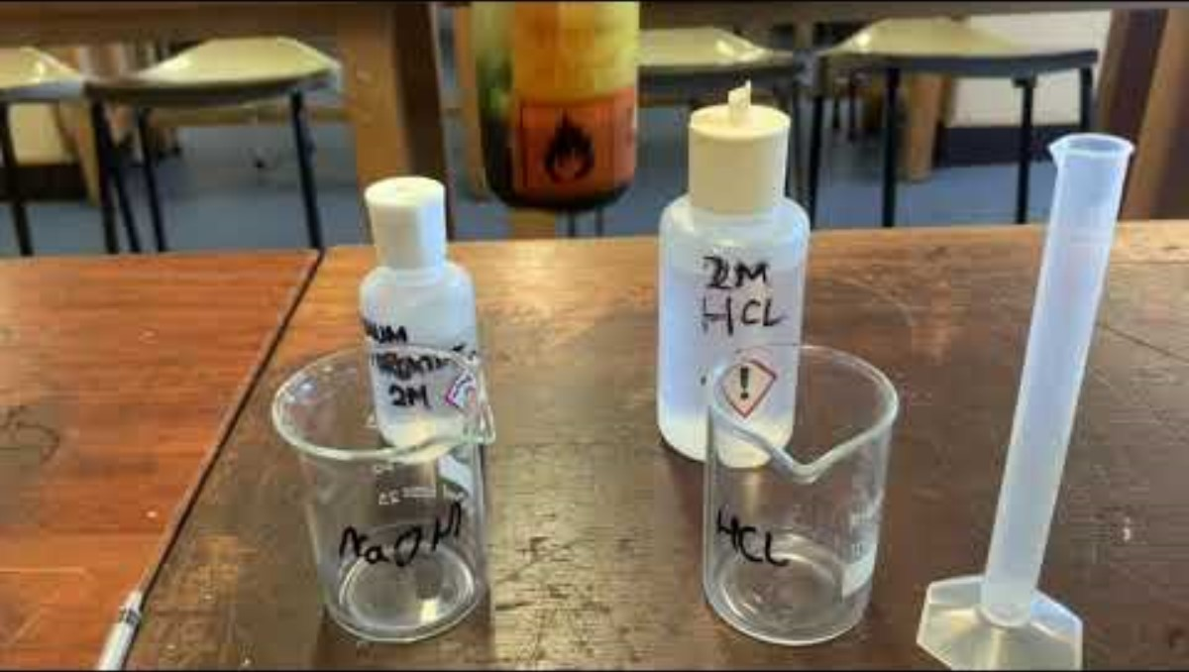

Slide 11
Find the Safety Data Sheets for the chemicals that we are going to use.
Read the precautions for safe handling.
Read the first aid for eye contact and skin contact.
Read what to do if we have a minor spill.

Slide 12
Do the experiment yourself.

Slide 13
Why can't we 'see' the salt?
Why did the pH (colour) change so quickly?
Why is it difficult to get the middle range pH's?

Slide 14


Slide 15
Acids with metal carbonates
Acid + Carbonate
Salt + H₂O + CO₂
The METAL from the carbonate and the chloride, sulfate or nitrate from the ACID
e.g. Magnesium chloride from magnesium carbonate and hydrochloric acid
MgCO₃ + 2(HCl) >>>> MgCl₂ + H₂O + CO₂

Slide 16
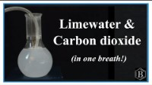

Slide 17
Metals with acids
Use the Pop Test to detect hydrogen gas.
(Requires a burning wooden splint or taper)
Metal + Acid
Salt + Hydrogen Gas
METAL and the chloride, sulfate or nitrate from the ACID
e.g. Zinc nitrate from zinc and nitric acid
Zn + 2(HNO₃) >>>> Zn(NO₃)₂ + H₂

Slide 18
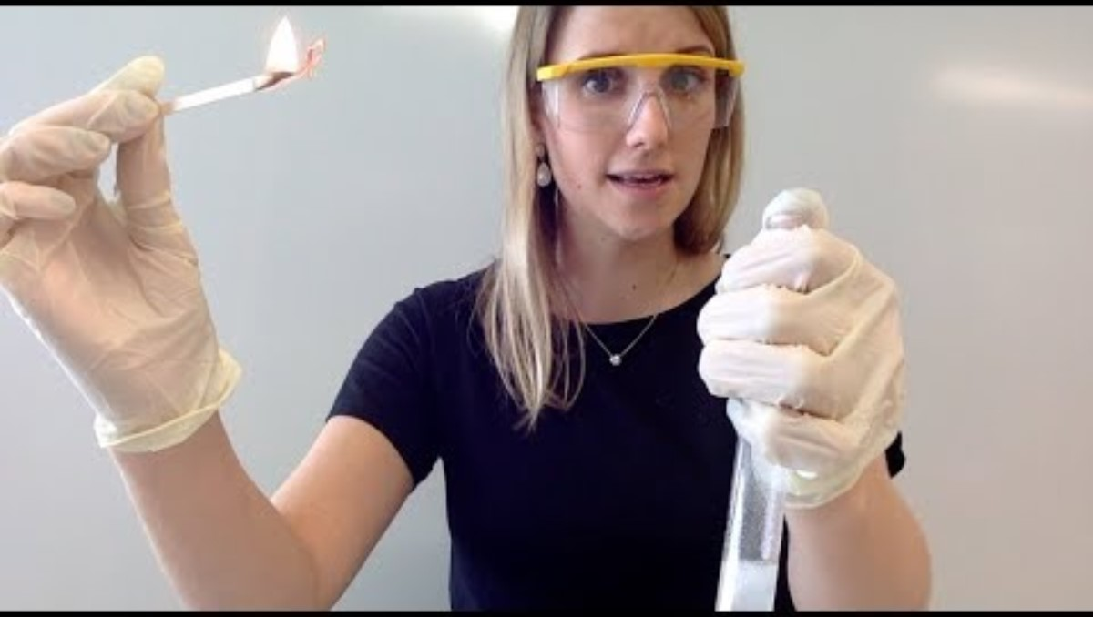
'Squeaky' pop test for hydrogen gas (H₂).

Slide 19


Slide 20
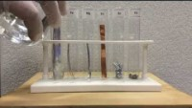

Slide 21
Are you now able to….
Write the word equation and identify reactants and products in balanced chemical equations for reactions, including;
Acid and base (metal oxides or hydroxides)
Acid and carbonate
Acid and metal

Slide 22
Are you now able to….
Predict the products from observations from reactions, including;
Acid and base (metal oxides or hydroxides)
Acid and metal

